Slide 1
BiR Intro to AI TA Slides

Slide 2
Breakout Session 1: Set Up
5-10 mins

Slide 3
Session Objectives
Ensure that students have the proper software installed

Slide 4
Software Requirements
All students must have Python 3 installed on their computers
https://www.python.org/downloads/
Students are welcome to use their own IDEs (PyCharm, Spyder, IDLE etc)
All students must have the ability to use the python package installer pip
If they do not, please help them install pip and add it to their system paths
https://www.activestate.com/resources/quick-reads/how-to-install-pip-on-windows/
https://www.geeksforgeeks.org/how-to-install-pip-in-macos/

Slide 5
Software Requirements (Continued)
Please have the students install the follow the following libraries using pip
Pygame ( pip install pygame) - For the Al algorithm
Pillow (pip install Pillow) – for image processing

Slide 6
GitHub Repository
All files for the section can be found here: https://github.com/SpaceCadetShep0727/BiR-intro-to-AI
Instruct students to download the repository zip file and extract it

Slide 7
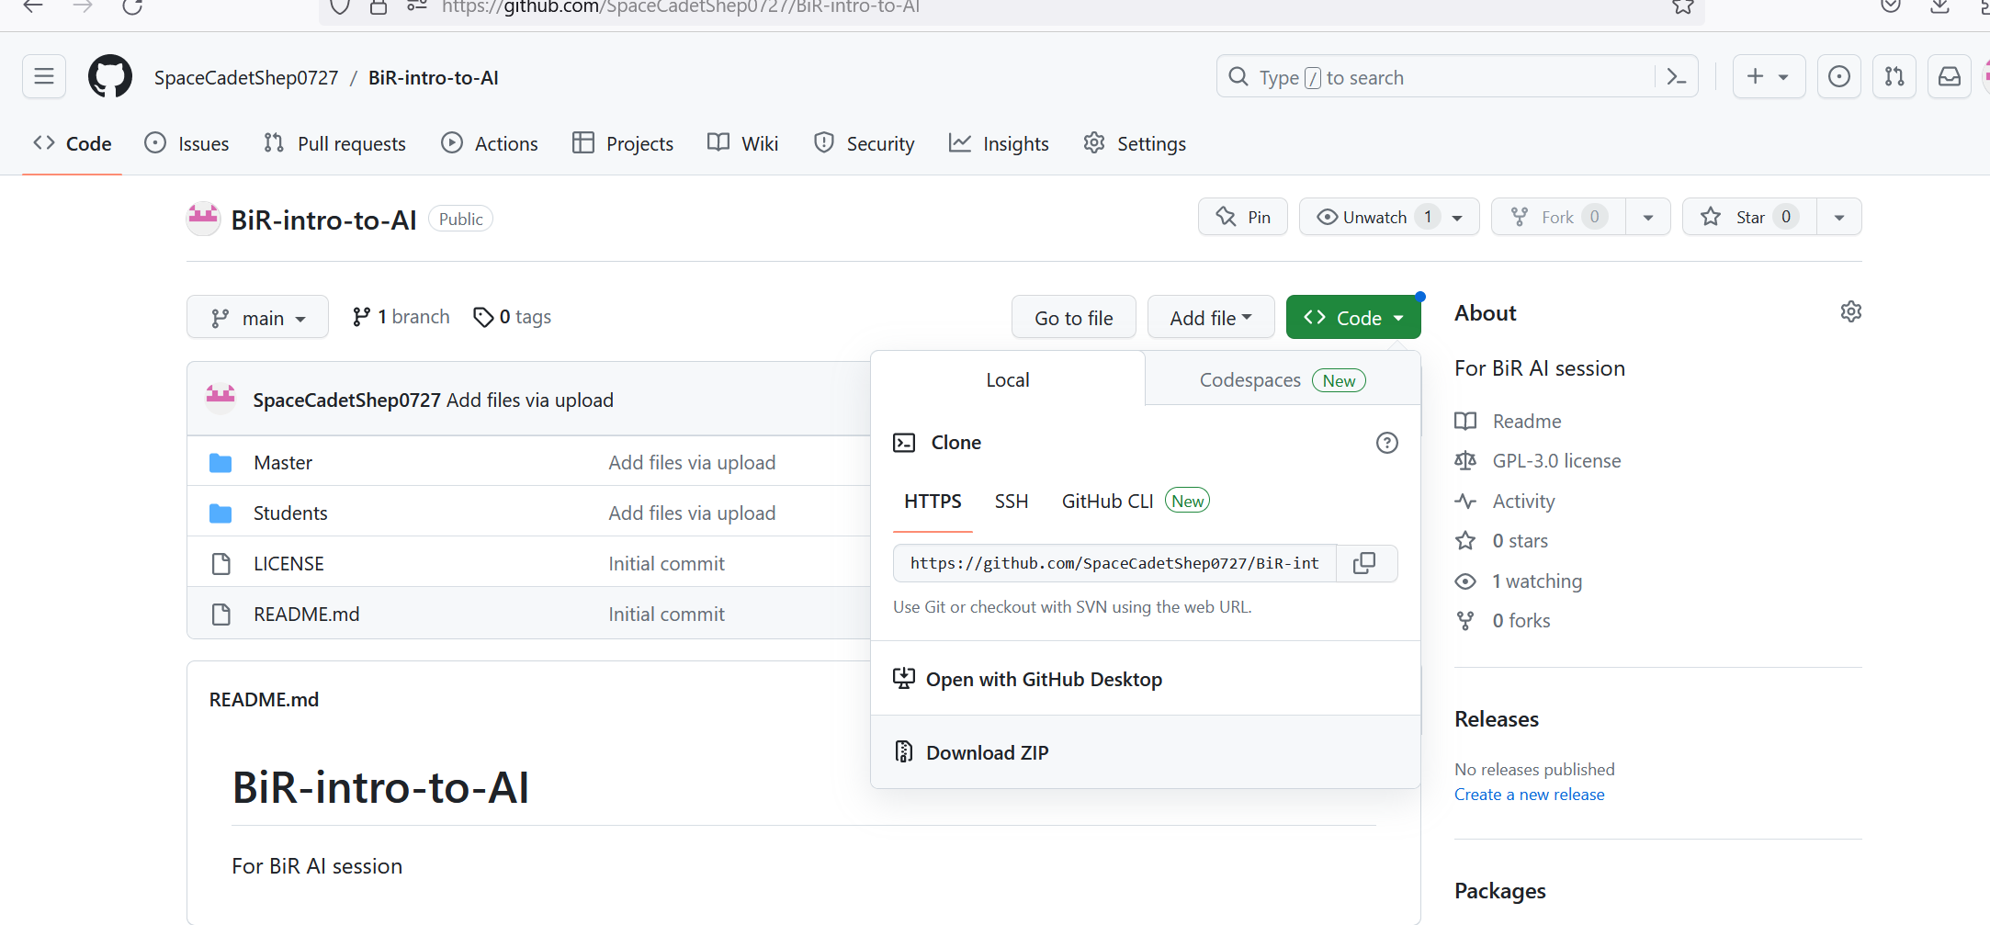

Slide 8
Student code for each breakout session is located in the student’s folder
TA master code is available in the master folder

Slide 9
Breakout Session 2: Intro Image Processing
15-20 mins

Slide 10
Objectives
Expose students to the basics of image processing

Slide 11
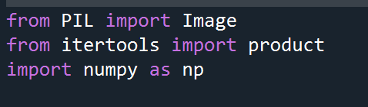
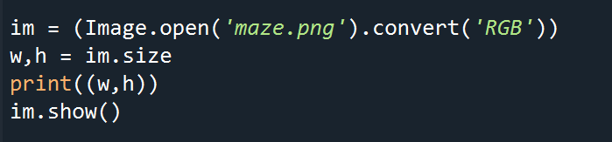
Session 2
First have the students import the necessary modules
Next have the students read in the maze image and display it along with the dimensional information
Challenge the students and ask them what w and h represent

Slide 12

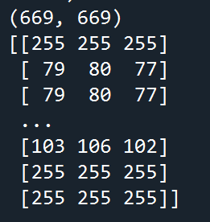
Session 2
Add these next lines to the code and ask the students what the they think of the output
The students will probably comment on how confusing it is
Explain to the student each pixel in a colored image is
represented by an element of a 3-dimensional array

Slide 13
Session 2
Ask the students if all this information is really necessary for our application (it isn’t) then ask them what they can do to make the image easier to process
The answer is to convert the image into black and white
Instead of representing 3 colors now each pixel only represents 1
Much easier to work with!
Preferred if your AI application doesn’t need to recognize colors

Slide 14
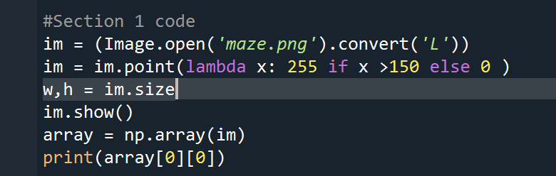
Session 2
To convert the image into black and white use the following code
Convert(‘L’) converts the picture to grey scale
The lambda function biases the pixels to either be black or white

Slide 15
Breakout Session 3: Pathfinding with A * Algorithm
15-20 mins

Slide 16
Objectives
Familiarize students with instances of the A* pathfinding algorithm
Challenge students to recreate the maze that their robot must navigate

Slide 17
Session 3
This section will not require any code changes !
Instead the students will focus on working with an instance of an A* algorithm
Instruct the students to navigate to the Session 3 folder and run the astar_intro.py file

Slide 18
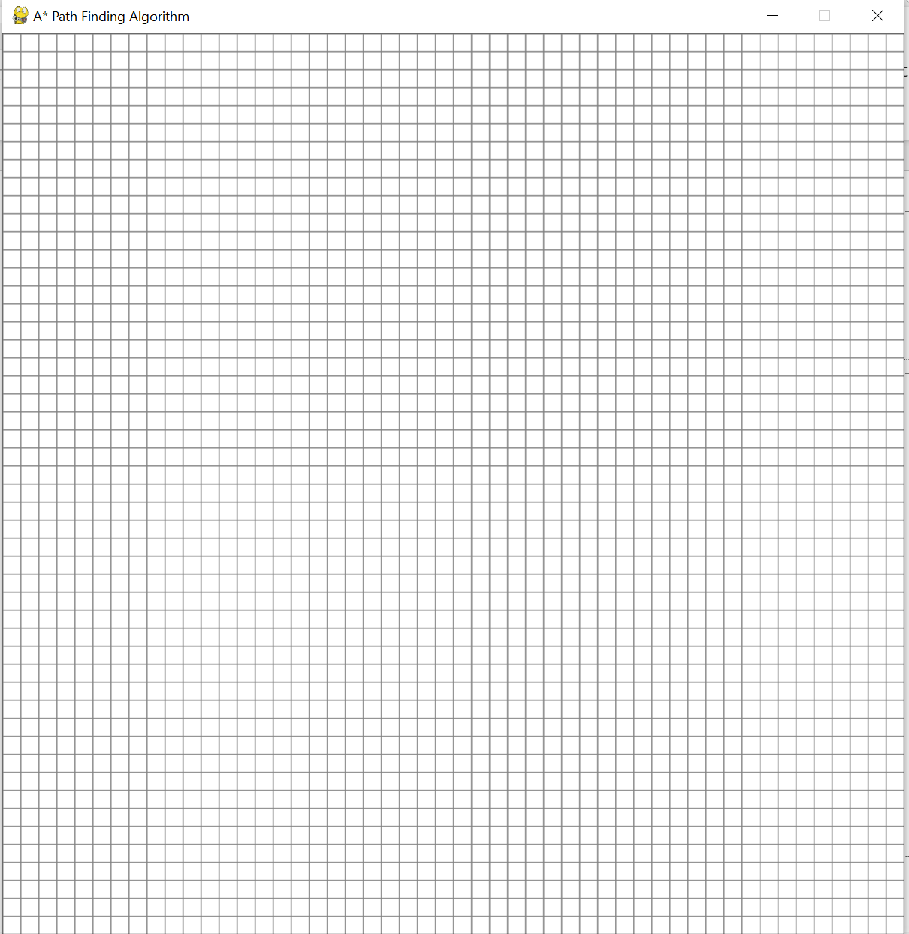
Session 3
A grid should be visible

Slide 19
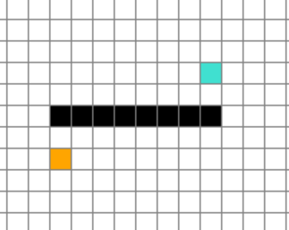
Session 3
The first grid you left click on will become orange
This represents the start point
The next grid will become blue
This represents the end point
Every click after will turn the grid black
This represents a wall
You can hold and drag to create walls quickly
A right click undoes the previous click

Slide 20
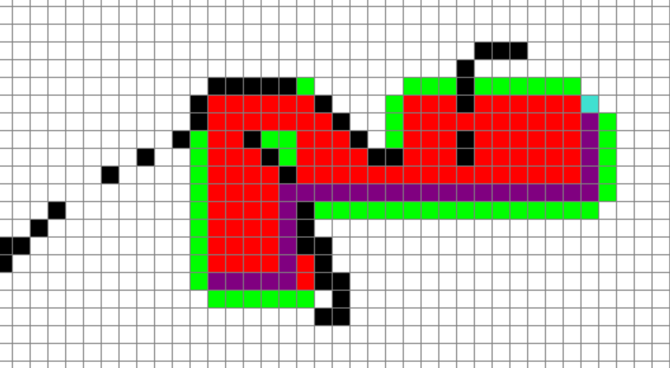
Session 3
Hitting the spacebar starts the algorithm
Green represents an open node
Red represents a closed node
Once the target destination is reached a path is traced back (purple)

Slide 21
Session 3
Have the students make their own paths to solve (~5mins)
Ask the students to recreate the maze shown in ‘maze.png’ with the start and endpoints in the algorithm grid
Ask if they think there’s a more effective way to recreate the maze
Bonus: Ask them how image processing could be used instead of manually drawing the maze

Slide 22
Session 4: Pathfinding with Computer Vision

Slide 23
Objectives
Integrate A* algorithm code with computer vision to create an autonomous maze solver for our robot

Slide 24
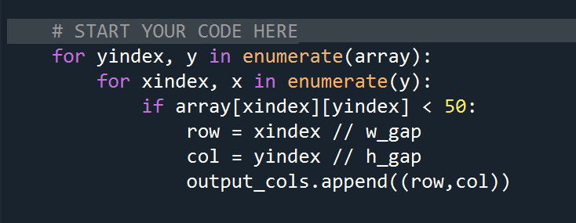
Session 4
In the Cpu_vision.py file replace the marked section of code with
This code breaks our maze picture into grid (just like our algorithm window) and then marks the (row, col) that have black pixels in them (they represent the maze walls)

Slide 25
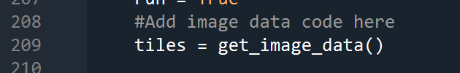
Session 4
Open the astar.py file
At line 209 add this line of code (you will see add image data comment)
Ask students to run the program and press the “f” key to fill in the maze data

Slide 26
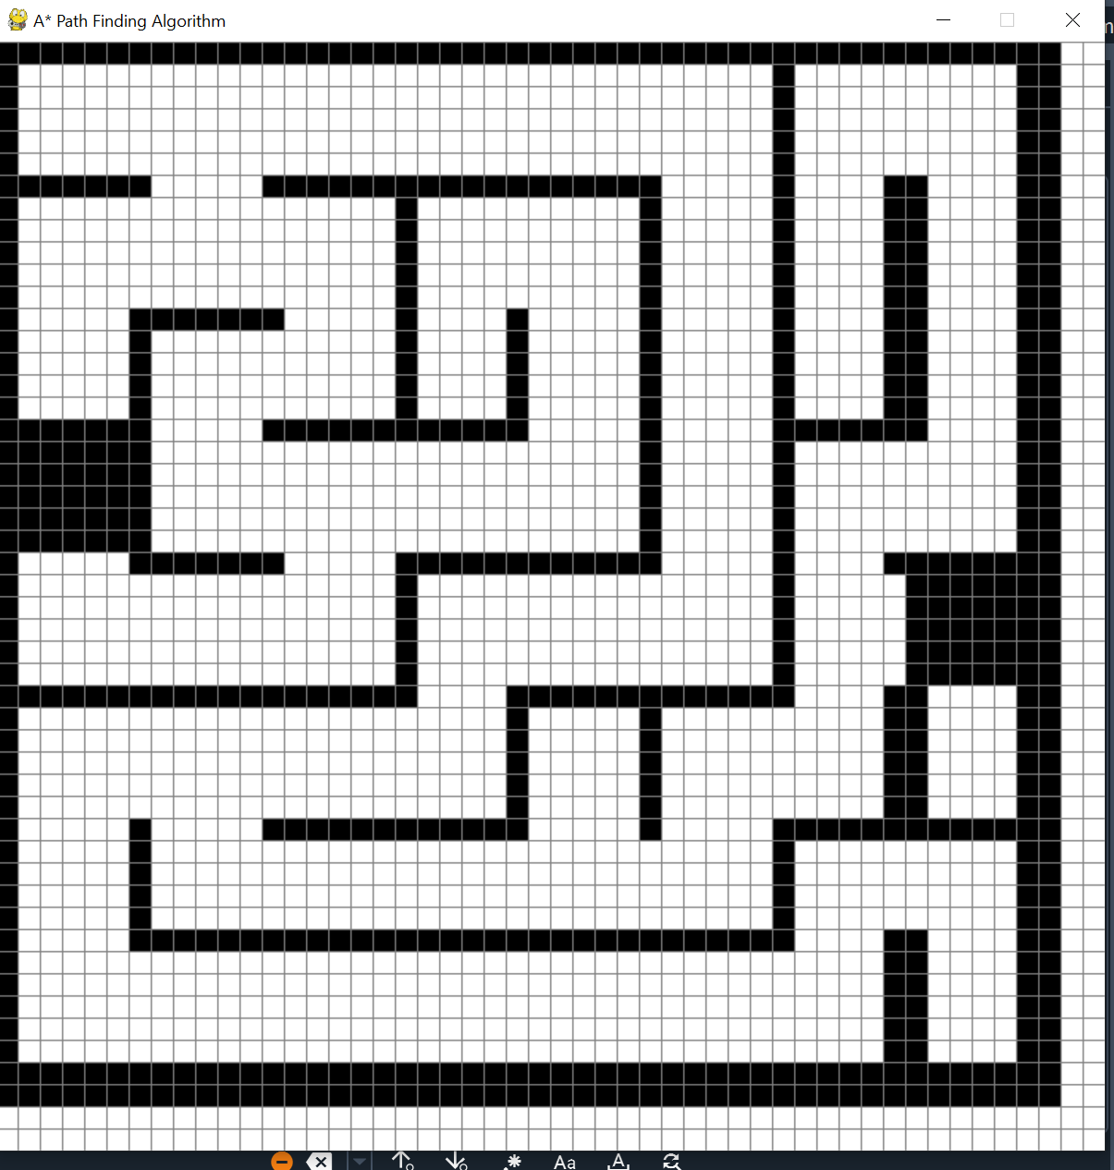
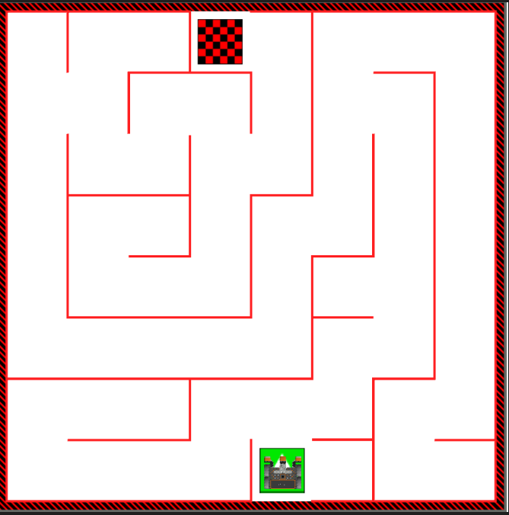
Session 4
Notice that the generated maze is rotated from the original maze
Ask students why that may be
It should look something like this

Slide 27
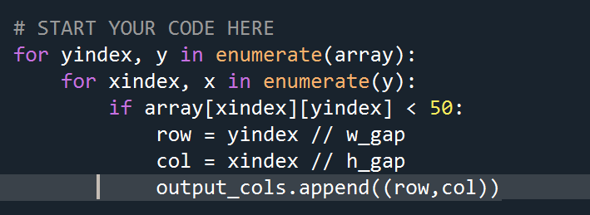
Session 4
After a few minutes tell the students that the maze is rotated because the image processer library we’re using (Pillow) swaps the x and y values
To fix this have the students go back to the Cpu_vision.py file and change the code to

Slide 28
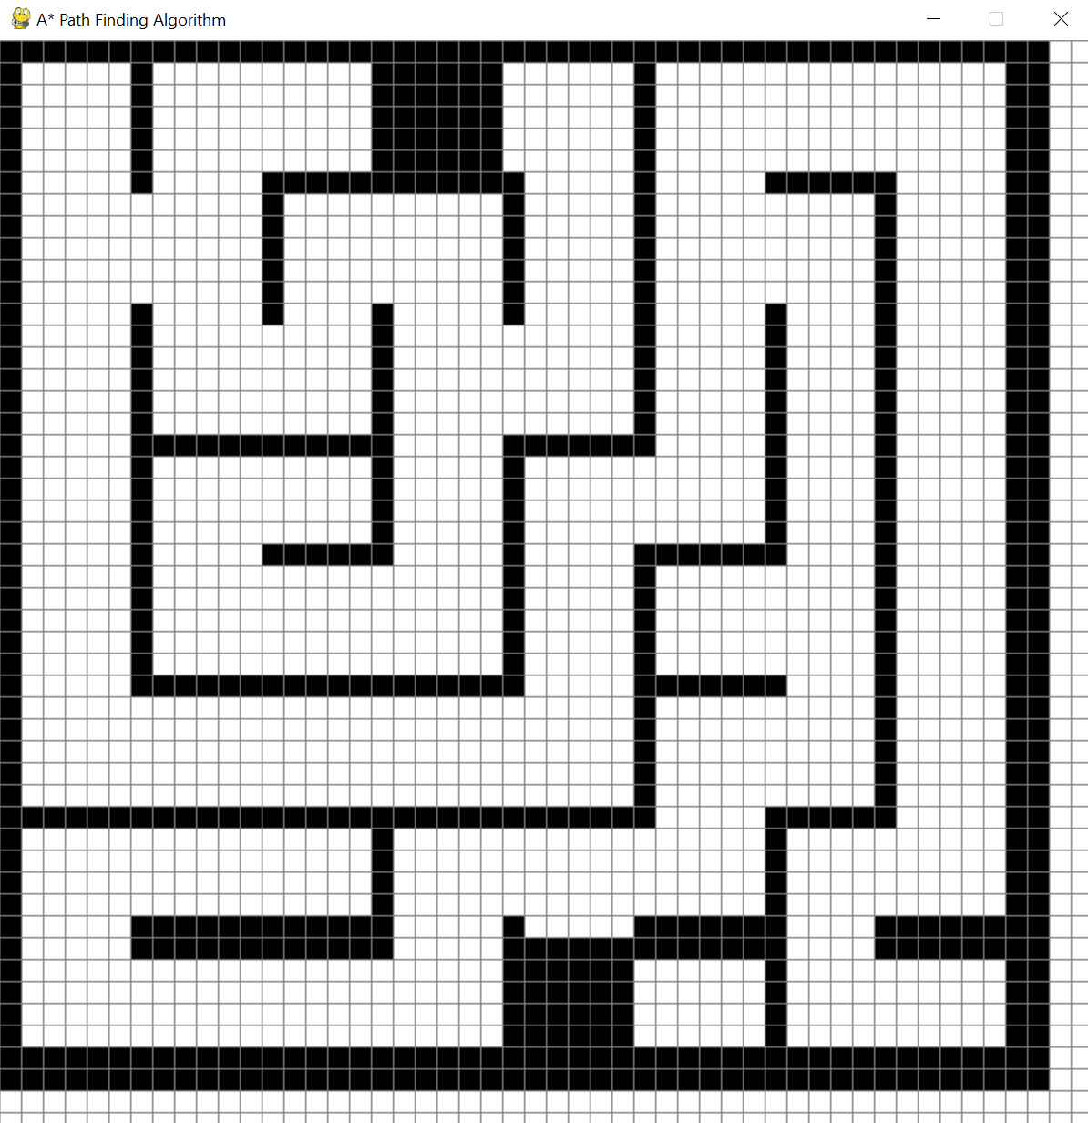
Session 4
Now it should look normal
Also note that the start and end blocks get marked by our algorithm
Students can manually erase those by holding right click and moving the mouse over those areas

Slide 29
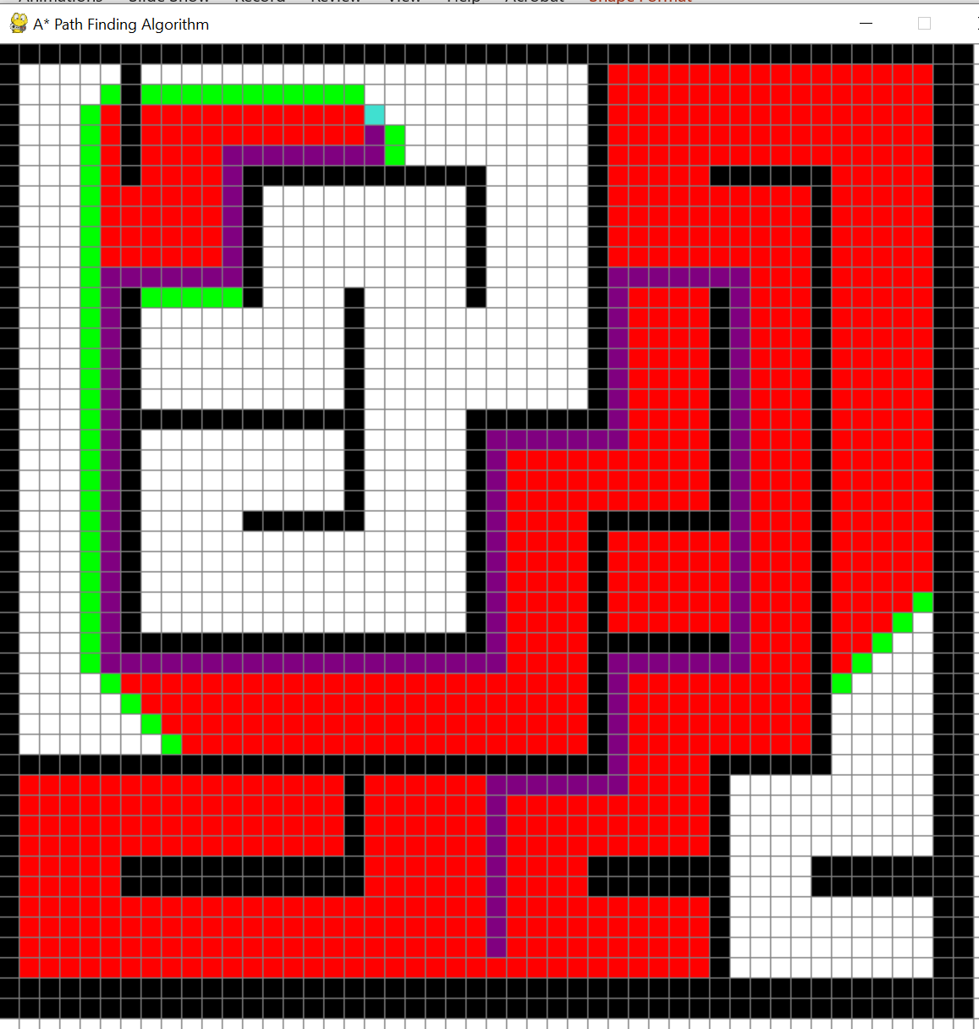
Session 4
Have students set their start and end points then hit the spacebar

Slide 30
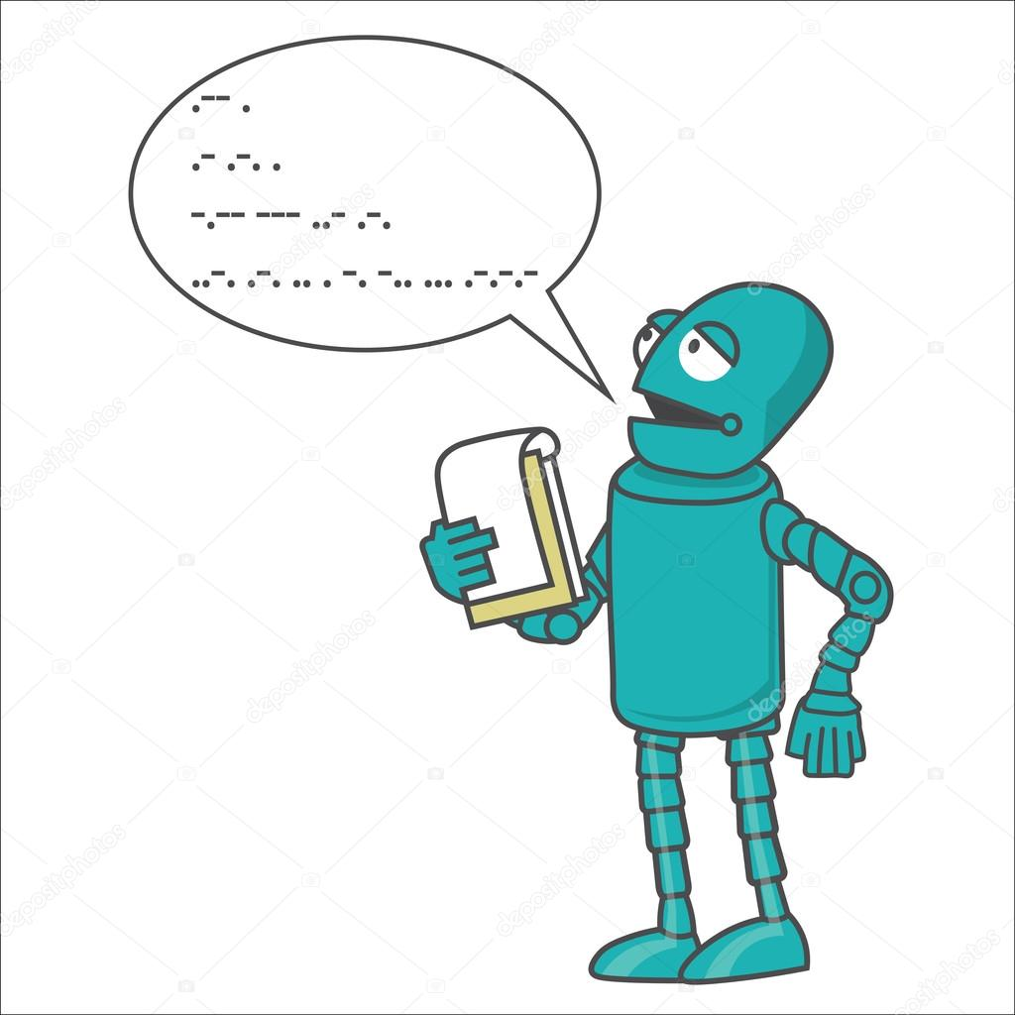
Session 5: Designing a Robot Controller
Now that we can solve the maze, we must find a way to convert that solution into commands that the robot can understand
Navigate to robot_controller.py

Slide 31
What we need to figure out
How far does the robot need to travel ?
How to tell the robot to turn ?

Slide 32
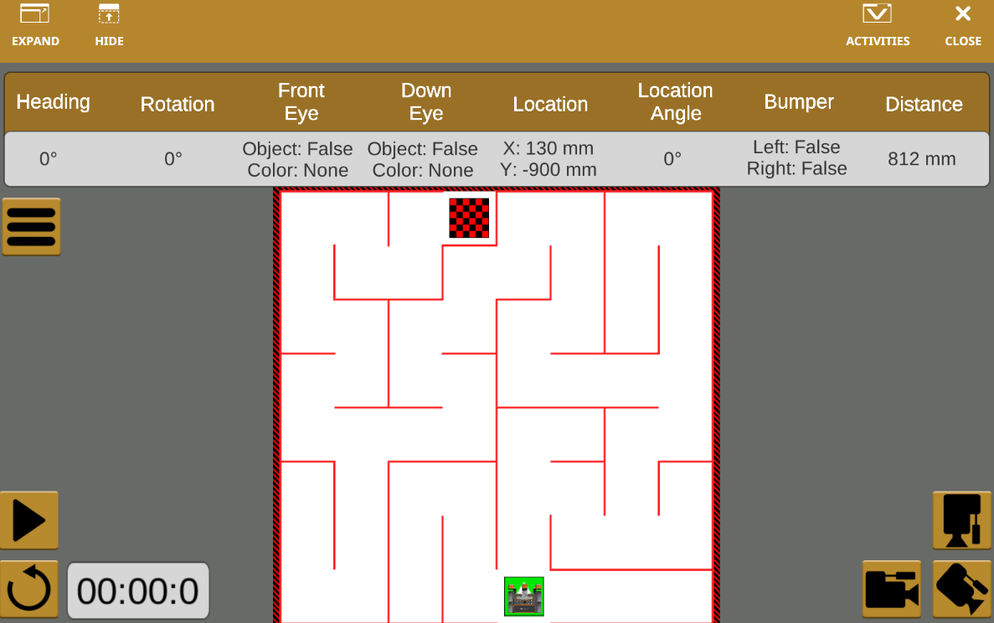
How Far Is Too Far?

Slide 34
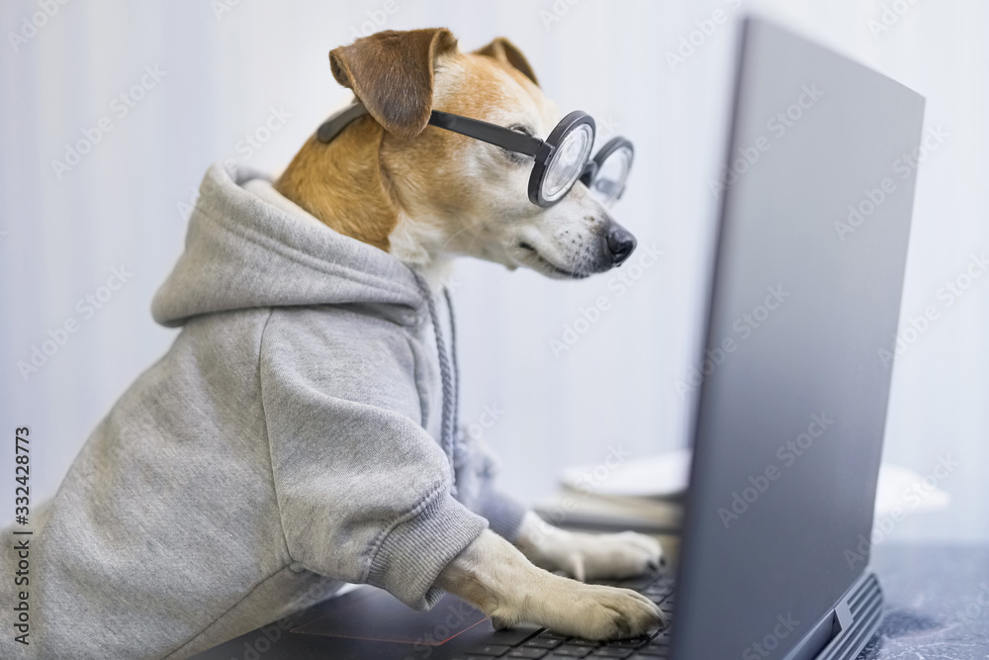
Let’s Code This

Slide 35

Tricky Turns
Figuring out how the tell the robot to turn is a little challenging
Coordinate System rotates as the robot rotates

Slide 36
What We Know
The path only changes by 1 square in either of the cardinal directions
No diagonals!
The path only goes forward
We assume the robot will start at the same heading
The path is returned to us as a series of squares

Slide 37
Defining a Coordinate System for Rotation
Assume positive angles are counter-clockwise
Need to tell robot to turn left x number of degrees

Slide 38
Simulating an IMU

Slide 39
Let’s Code This

